Slide 1
Predictive Data Mining
Movie success prediction model using decision tree
By Yamini Pathuri, Koundinya Raghava Nerella
Instructor: Aparna Varde
CSIT - 558: Data Mining
Montclair State University, NJ

Slide 2
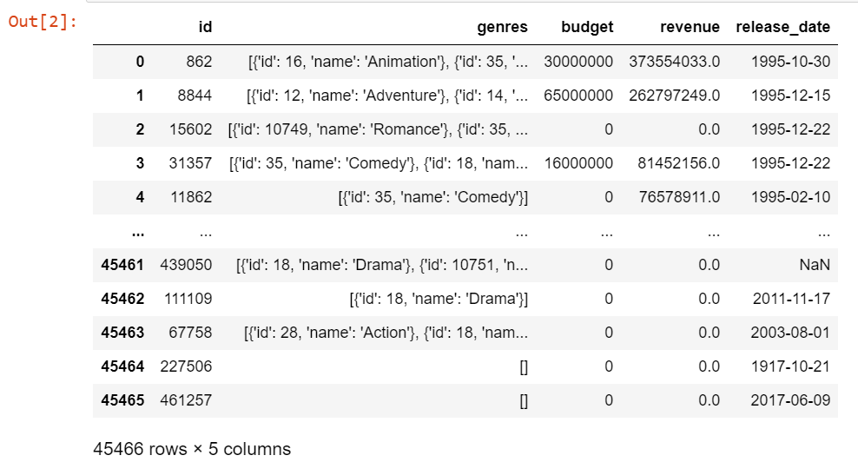
Data Description
The data is taken from Kaggle and consists of metadata for all 45,000 movies listed in the Full MovieLens Dataset. The dataset consists of movies released on or before July 2017.
We have considered 'id', 'genres', 'budget', 'revenue', 'release_date' for building our prediction model.

Slide 3
Goals:
We have chosen a simple goal of predicting the movie success based on it’s genre and release month.
We are aiming to build a model which takes the genre name and the release month as input and predicts how successful or unsuccessful the movie would be in terms of box office collections.

Slide 4
Techniques used
Data cleaning and transformation for making the data suitable for our prediction technique.
Using vectorizer to make the input compatible with the classifier.
Using decision tree classifier for the classification of the data based on its box office success
Creating a tool which take genre and month as sample input and tells us how successful the movie would be.

Slide 5
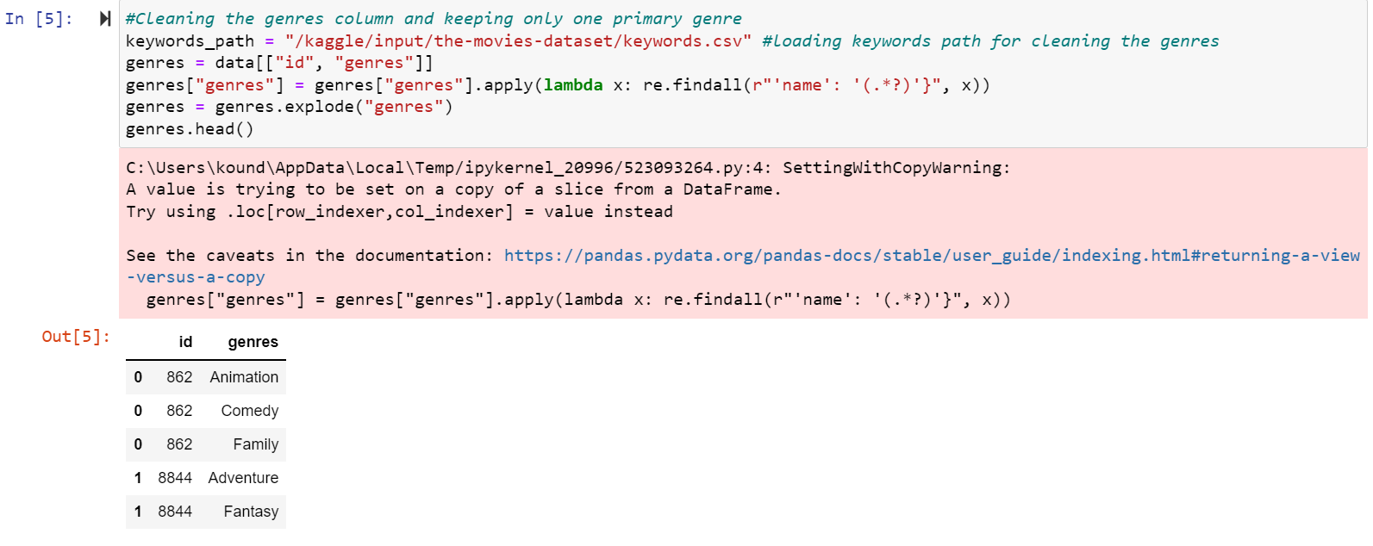
Execution
The genres column in our data has 3 genres for each movie and we would like to focus only its primary genre for our analysis and eliminate the rest..

Slide 6
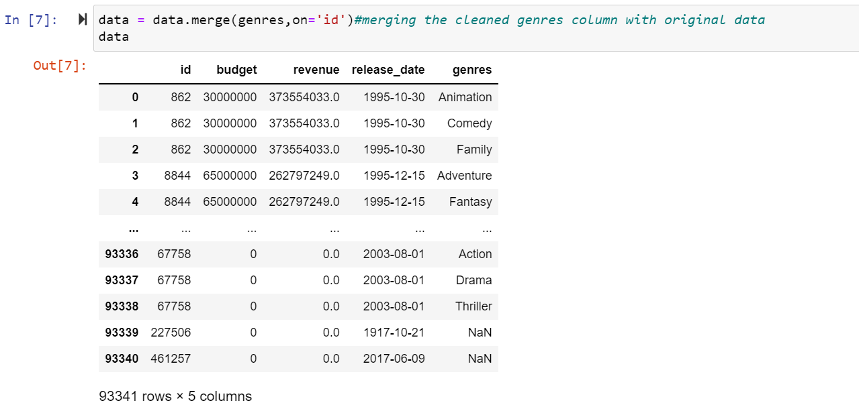

Slide 7
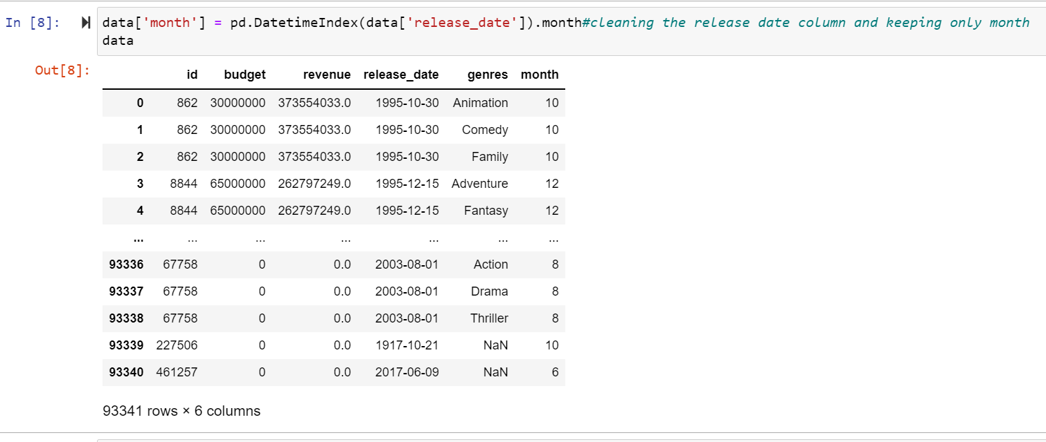
Extracting month from the release date

Slide 8
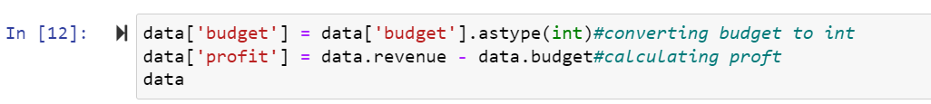
Calculating profit percentage and creating a success index

Slide 9
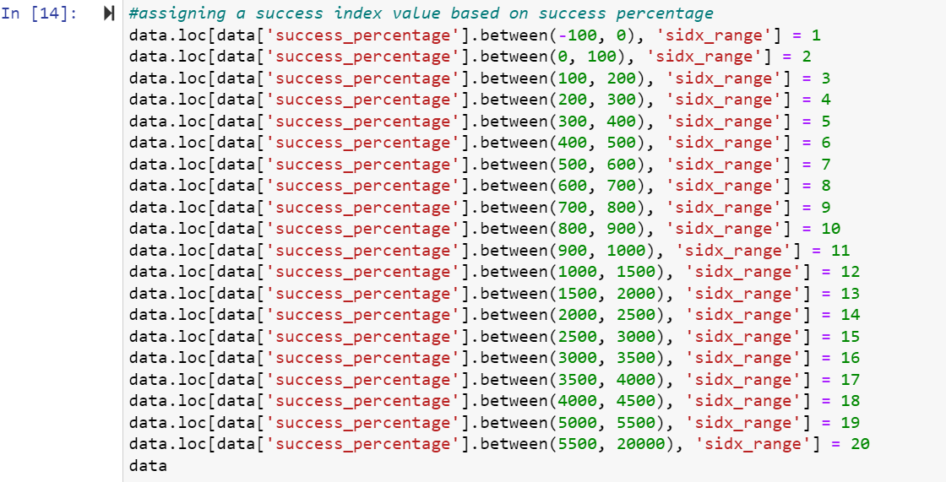

Slide 10
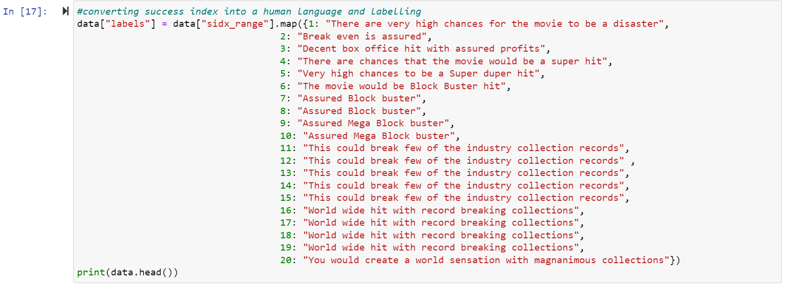
Labelling the success index

Slide 11
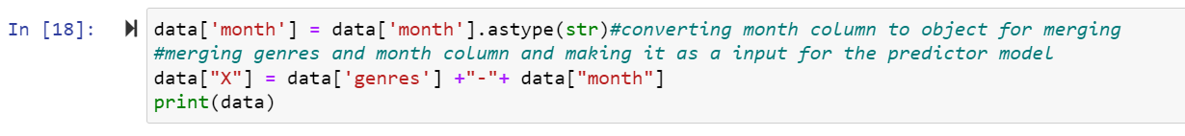
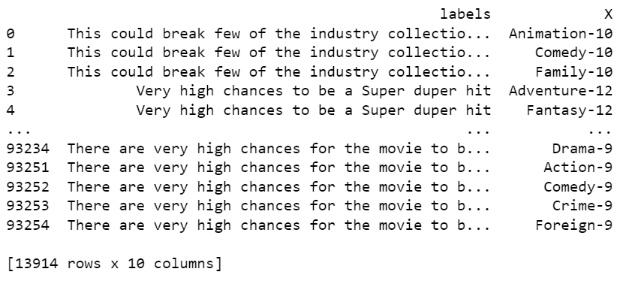
Merging data and month column to create single input

Slide 12
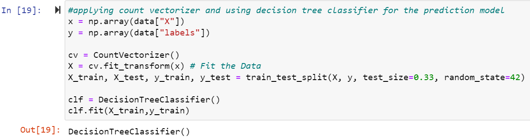
Using Countvectorizer and Decision Tree Classifier:

Slide 13
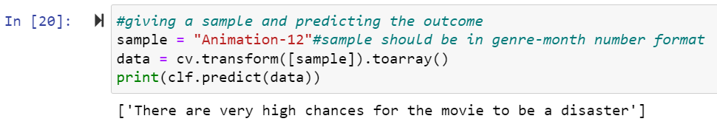
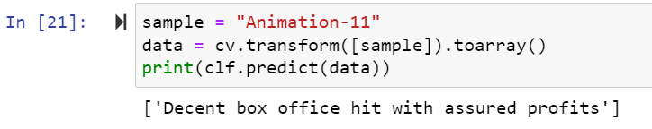
Prototype and Demo

Slide 14
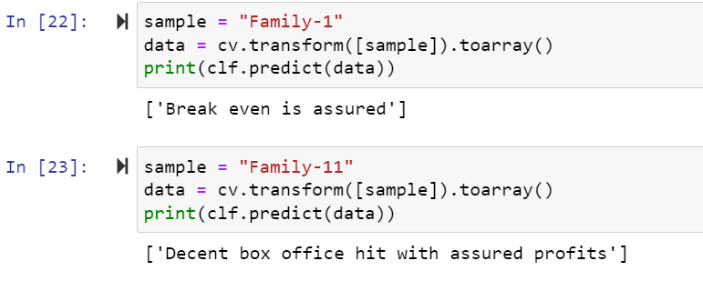

Slide 15
Conclusion and future work
Though our model predicts the success of a movie, it is not accurate as we have chosen only two parameters.
We aimed to keep the model simple in this assignment, as we focused on understanding the classifying techniques that we used.
Our goal is to consider more factors in future model (example: success record of the director, lead actor, plot line, user count and their average ratings etc.,) and build an efficient success predictor model.

Slide 16
References:
https://www.kaggle.com/datasets/rounakbanik/the-movies-dataset
https://monkeylearn.com/blog/data-preprocessing/
https://www.javatpoint.com/data-integration-in-data-mining
https://www.loginworks.com/blogs/how-to-work-with-data-summarization-techniques-in-data-mining/
https://www.javatpoint.com/data-cleaning-in-data-mining

